Slide 1


Bank Loan of Customers | Finance
Date:- 18th Sep 2022
Data Analyst
Project No. : P54
Group No : 05
Group Members
Anjali Kale
Gauri Agharkar
Aboli Hagone
Mayuri Yedave
Rohit Banate
Akshay Maskar
Yashraj Dalwe
Mentor:- Mr. Shubham Kabre

Slide 2
Project Objective
This is Bank loan of Customers project under the domain of Finance where we complied 2 datasets (Finance-1 & Finance-2) with .csv extension files having 39k rows each and the objective was to analyze the growth that bank got within given years in loans.
We solved 5 KPI’s using
Adv.Excel - Problem to Data - Pivot Table ,V-Lookup (Match Func.), MAXIFS
MySQL - Query implementation
Tableau & PowerBI - To showcase different views and corresponding dashboard.

Slide 3
Contents
KPI-1 : Year wise loan amount Stats
KPI-2 : Grade and sub grade wise revol_bal
KPI-3 : Total Payment for Verified Status Vs Total Payment for Non Verified Status
KPI-4 : State wise and last_credit_pull_d wise loan status
KPI-5 : Home ownership Vs last payment date stats

Slide 4
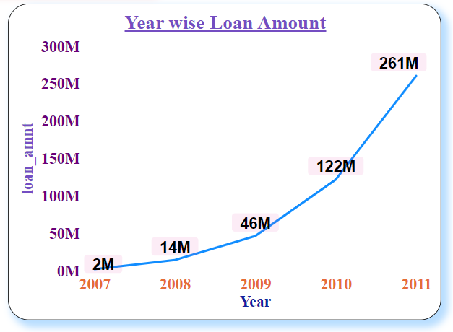
KPI_1
Year wise Loan Amount
Here, we have shown Year wise Loan Amount Visual:
One can observe that from year 2007 progressively loan amount has been increased (positive trend).
In year 2007 loan amount was 2M and in 2011 loan amount was 261M.
Difference =(261 -2)M= 259 M → 4 year growth
Grand Total of Annual Income : 446M
1

Slide 5
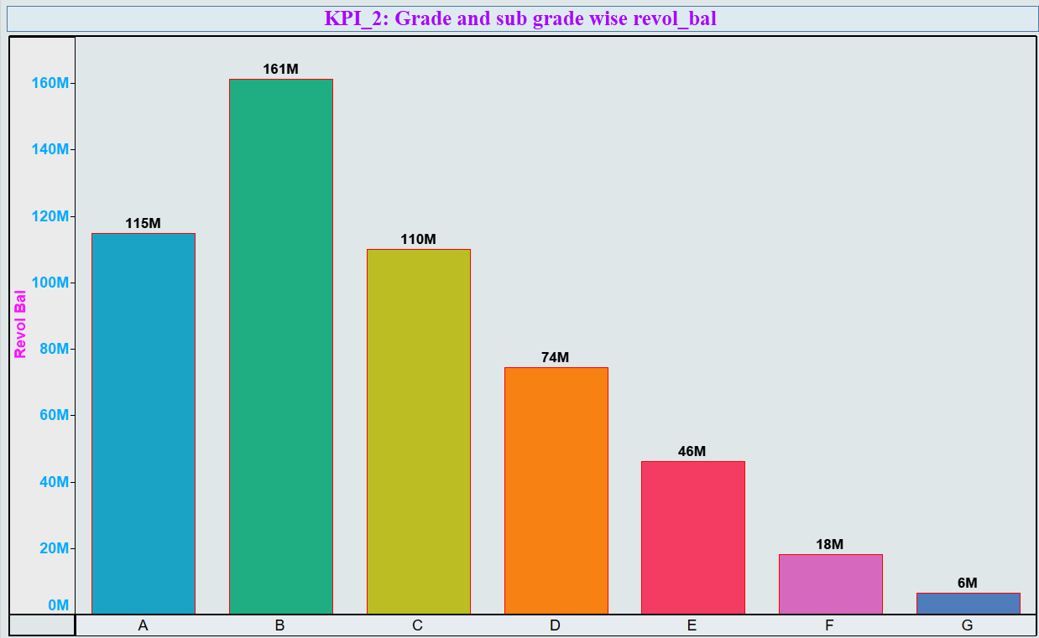
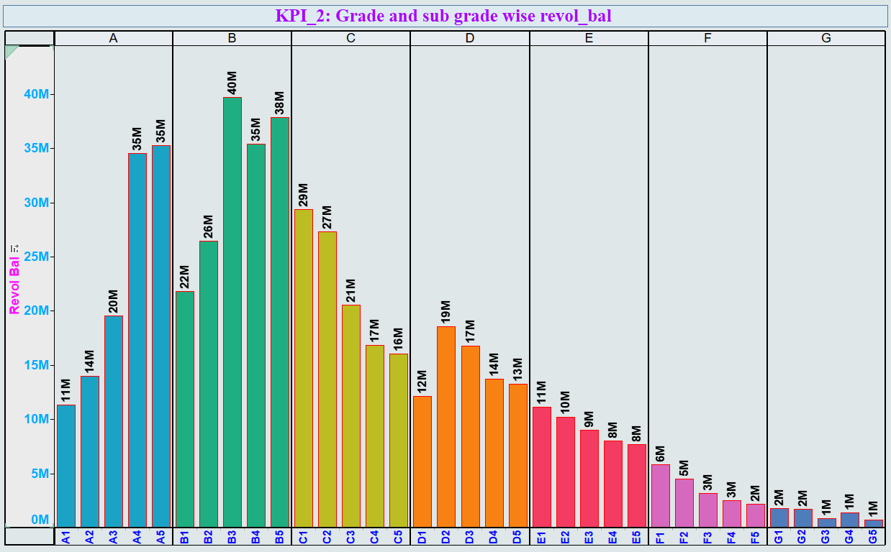
KPI_2
Grade and Sub-grade wise Revol_Bal
Here, We have illustrated Grade and Sub-grade wise Revol_Bal Visual:
In this visual, we can observe grade B has highest Revol_Bal : 161M among all grades.
Parallel by drill down ,one can observe sub-grade visual for corresponding grade.
And least value of Revol_Bal has shown for grade G : 6M.
If we see the trend ,it looks like
B > A > C > D > E > F > G
2

Slide 6
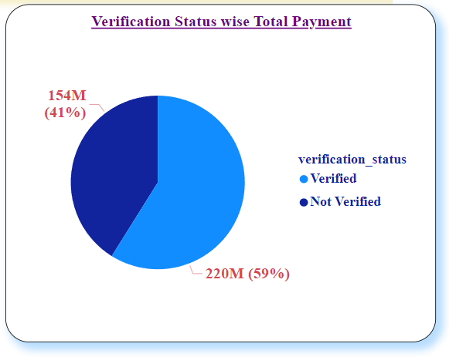
KPI_3
Total Payment for Verified Status Vs Total Payment for Non Verified Status
Here, we have depicted Total payment wise Verification Status Visual:
This is the first step of verification status.
In this visual, we can observe two verification status i.e. Verified & Non Verified.
But with respect to Total Payment distribution one can observe that Verified : 59% and Non Verified : 41%.
3

Slide 7
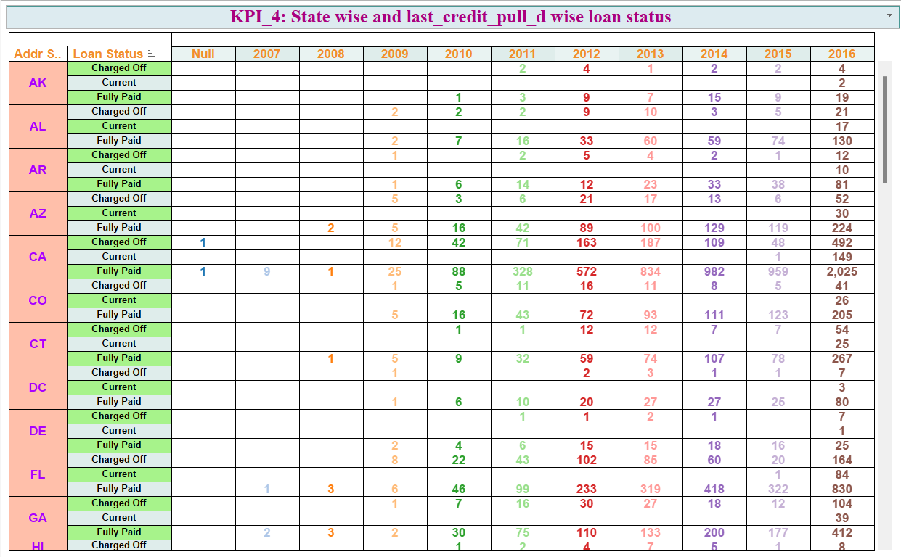
KPI_4
State wise and last_credit_pull_d wise loan status
Here, we have presented State wise last_credit_pull_d wise loan status Visual:
For each state based on last credit pull date wise year ,loan Status of Fully paid was maximum among listed loan status which was around 83%.
Count of Each Loan Status:
Charged off- 5629
Current - 1140
Fully Paid - 32949
4

Slide 8
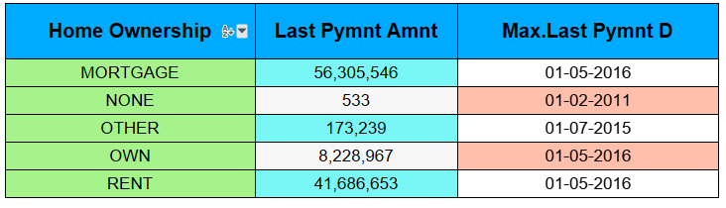
KPI_5
Home ownership Vs last payment date stats
Here, we have described Home Ownership wise last payment date Visual:
If we observe neatly Last payment Amnt for MORTGAGE : 56,305,546 was higher among home ownership category.
Finally we can say that many customers was yet to repay their loan amount for their corresponding home ownership.
5

Slide 9
THANK YOU

